Slide 1

A Project Work-II
SRS Presentation
Title: Human Activity Recognition System
Department of Information Technology Engineering
Faculty of Engineering
MEDI-CAPS UNIVERSITY, INDORE- 453331
Session-2020-2021
SUBMITTED BY
Priyanshu Jain (En17IT301073)
Samyak Jain(En17IT301083)
Sarthak Ranka(En17IT301085)
GUIDED BY
Ms. Shruti Dhanotiya

Slide 2
OBJECTIVE
Our objective of project is to recognize the human activity using Human Activity Recognition System using CNN and LSTM Model.
Human activity recognition (HAR) aims to classify a person's actions from a series of measurements captured by sensors. Action recognition concerns the extraction of activity based knowledge, image data relationship or other patterns implicitly or explicitly stored in the images

Slide 3
INTRODUCTION
Human activity recognition using smartphone sensors like accelerometer is one of the hectic topics of research. HAR is one of the time series classification problem. In this project various machine learning and deep learning models have been worked out to get the best final result. In the same sequence, we can use LSTM (long short term memory) model of the Recurrent Neural Network (RNN) to recognize various activities of humans like standing, climbing upstairs and downstairs etc.
LSTM model is a type of recurrent neural network capable of learning order dependence in sequence prediction problems. This model is used as this helps in remembering values over arbitrary intervals.
Classifying the type of movement amongst six categories:
WALKING,
WALKING_UPSTAIRS,
WALKING_DOWNSTAIRS,
SITTING,
STANDING,
LAYING.

Slide 4
Tools Required
Python 2.7 is used during development and following libraries are required to run the code provided in the notebook:
Tensorflow
Numpy
Matplotlib
Pandas

Slide 5
PROBLEM DOMAIN
Human activity recognition concerned with identifying the specific movement or action of a person based on sensor data.
The problem is to predict the activity given a snapshot of sensor data, typically data from one or a small number of sensor types. Generally, this problem is framed as a univariate or multivariate time series classification task.
It is a challenging problem as there are no obvious or direct ways to relate the recorded sensor data to specific human activities and each subject may perform an activity with significant variation, resulting in variations in the recorded sensor data.
The intent is to record sensor data and corresponding activities for specific subjects, fit a model from this data, and generalize the model to classify the activity of new unseen subjects from their sensor data.

Slide 6
SOLUTION DOMAIN
With the available data, we would like to train a neural network in order to understand if a person is performing any of the six activities. Once the neural network has been trained on the existing data, it should be able to correctly predict the type of activity a person is conducting when given previously unseen data.
The solution to this problem is a deep neural network. Based on the available data it will learn how to differentiate between each of the six activities. We can then show new data to the neural network and it will tell us what the user is doing at any particular point in time.

Slide 7
FUNCTIONAL REQUIREMENTS
Preprocessing of raw data
Data stream segmentation
Feature extraction
Feature transformation (with dimensionality reduction)
Classification

Slide 8
NON -FUNCTIONAL REQUIREMENTS
Security
Reliability
Performance
Maintainability
Scalability
Usability

Slide 9
Goal of Implementation
Human activity recognition, or HAR, is a challenging time series classification task.
The main goal of HAR systems is to observe and analyze human activities and to interpret ongoing events successfully.
It involves predicting the movement of a person based on sensor data and traditionally involves deep domain expertise and methods from signal processing to correctly engineer features from the raw data in order to fit a machine learning model.
By deep learning methods such as convolutional neural networks and recurrent neural networks will be capable of automatically learning features from the raw sensor data.

Slide 10
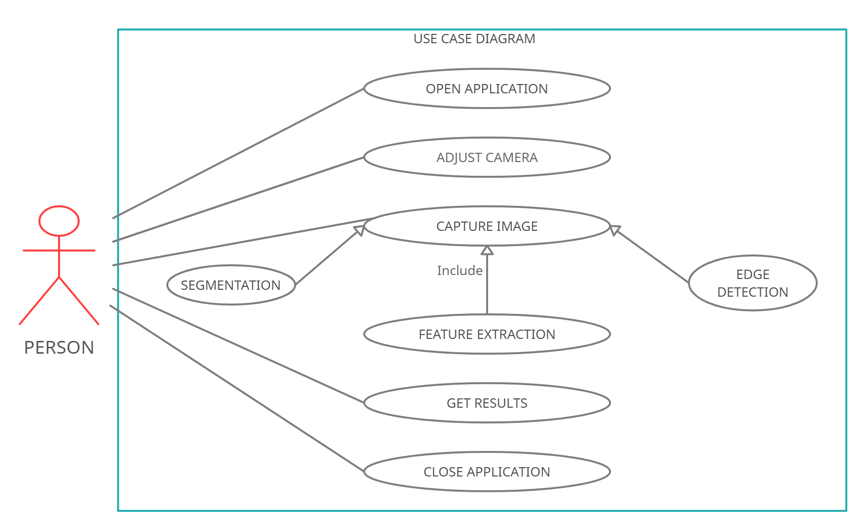
Use Case Diagram

Slide 11
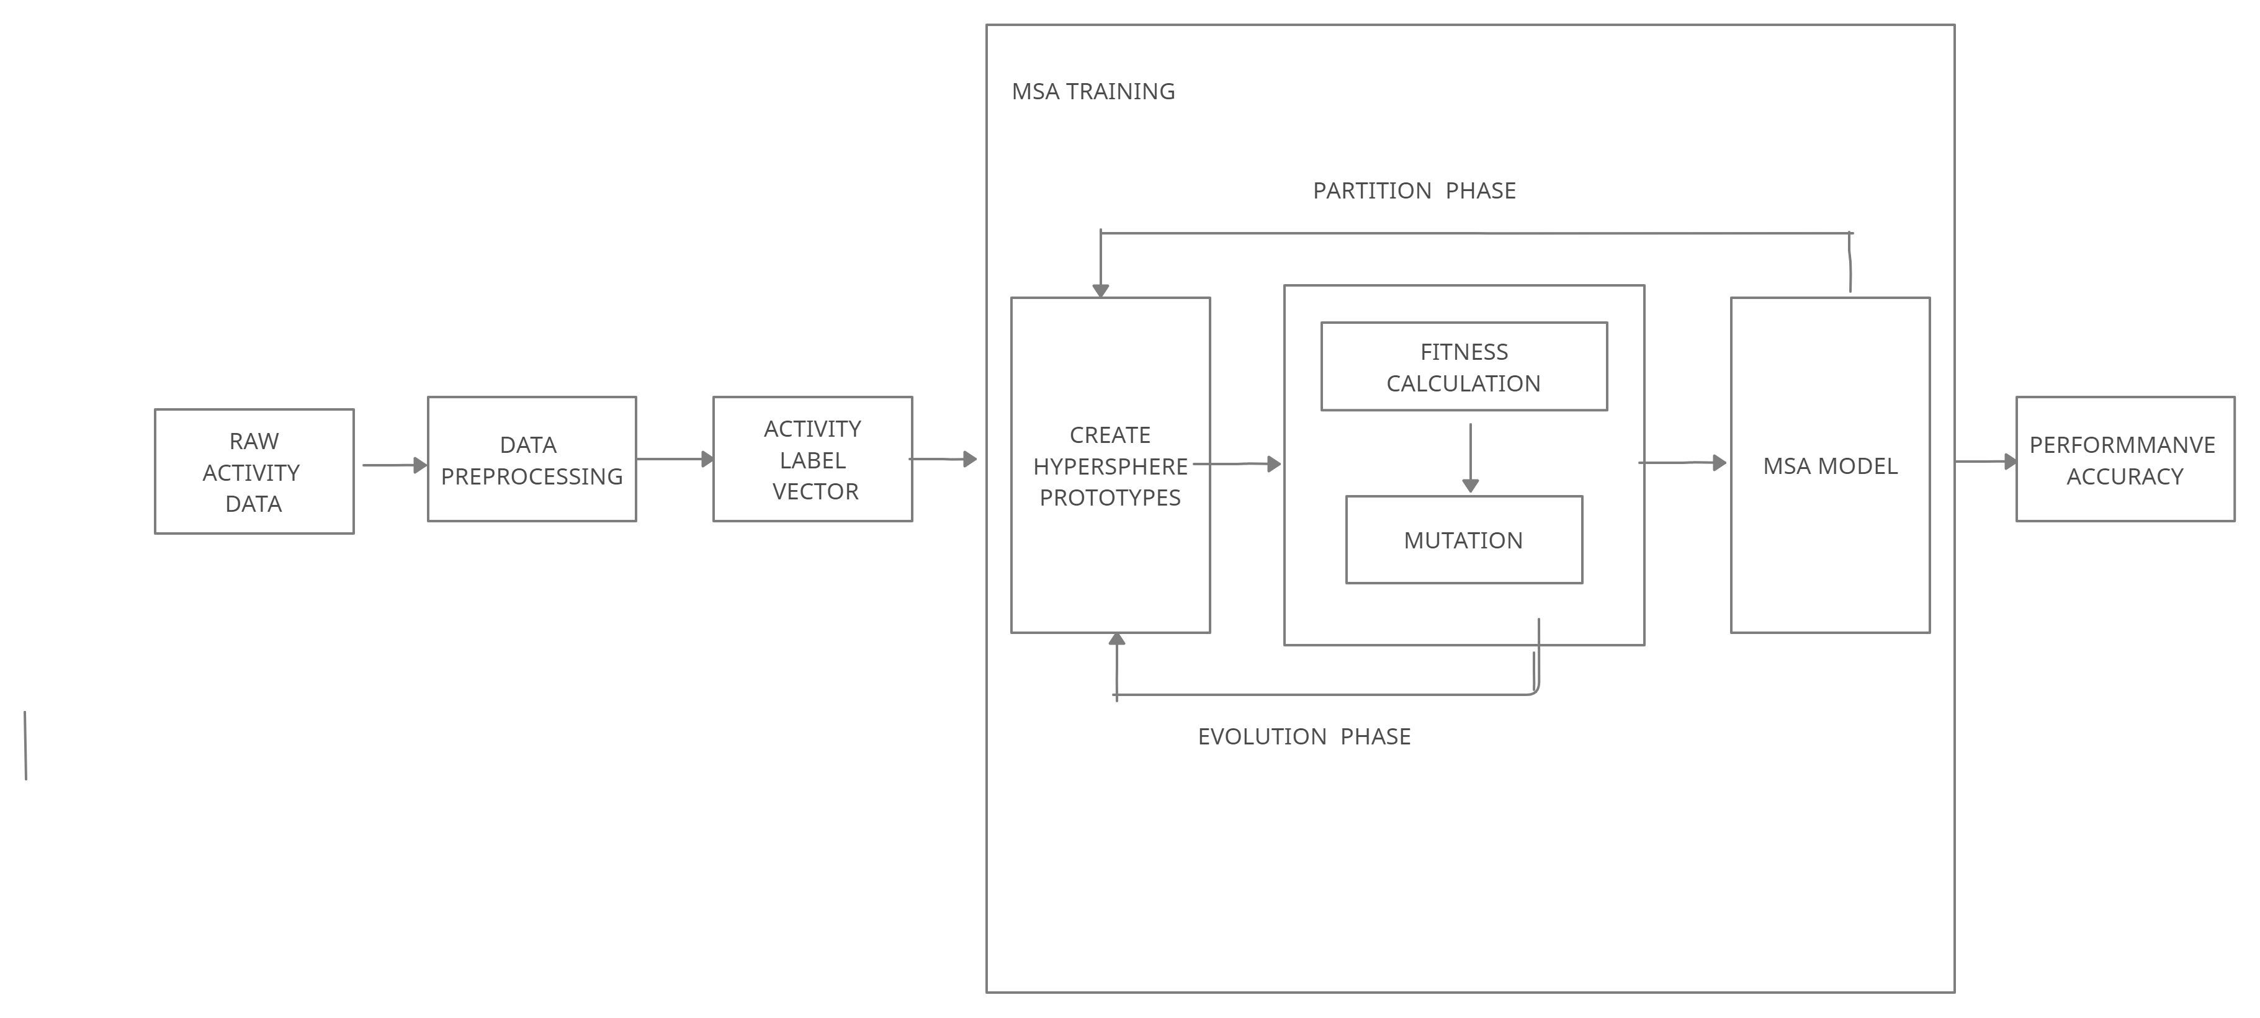
FLOW Diagram

Slide 12
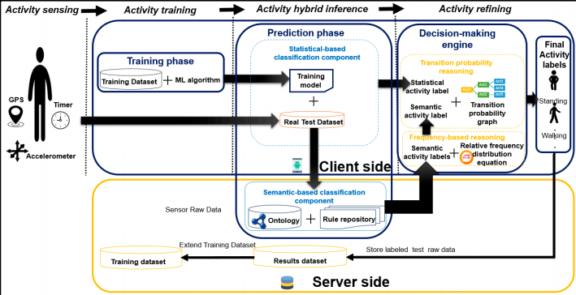
Framework architecture

Slide 13
Scope of Project
Human activity recognition has a wide range of uses because of its impact on wellbeing.
Nowadays, it is becoming a fundamental tool in preventing obesity or the care of elderly persons.
Activity recognition is the basis for the development of many potential applications in health, wellness, or sports etc.
Security and surveillance

Slide 14
References
1. Lara, O.D.; Labrador, M.A. A Survey on Human Activity Recognition using Wearable Sensors. IEEE Commun. Surv. Tutor. 2012, 15, 1192–1209.
2. Brezmes, T.; Gorricho, J.-L.; Cotrina, J. Activity Recognition from Accelerometer Data on a Mobile Phone. In Proceedings of the International Work-Conference on Artificial Neural Networks, Salamanca, Spain, 10– 12 June 2009; Springer: Berlin/Heidelberg, Germany, 2009
3. P. Turaga, R. Chellapa, V. Subrahmanian, and O. Udrea, “Machine recognition of human activities: A survey”, IEEE. Trans. Circuits Syst. Video Technol., Vol. 18, No. 11, pp. 1472-1488, 2008.

Slide 15
THANKS FOR YOUR PATIENCE !!!

